Slide 1
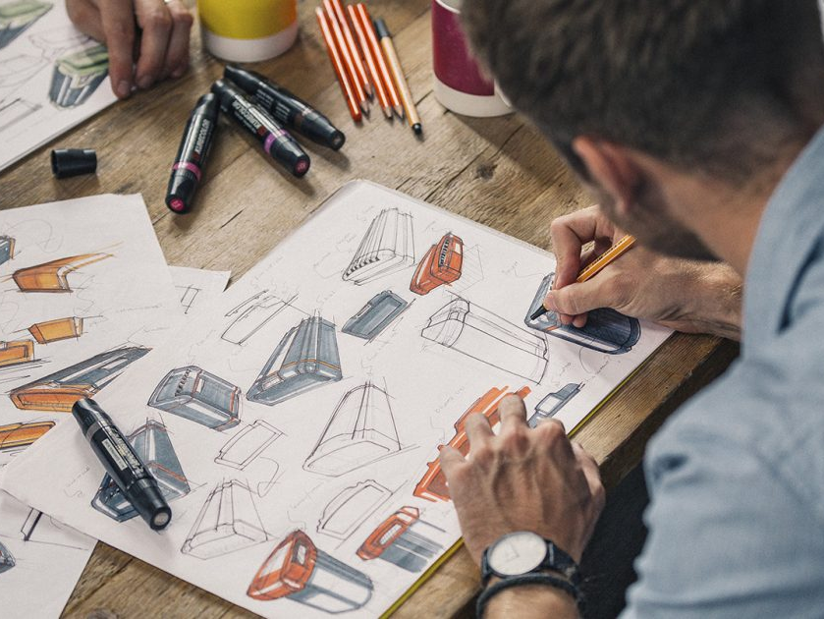
nat5 Design & Manufacture
Problem Identification and Brief

Slide 2
Learning intentions & success criteria
Learning Intentions
Understand what is mean by problem identification
Understand what is meant by a design brief
Success Criteria
I can describe and explain what problem identification is
I can explain what is meant by a design brief and give an example

Slide 3
Problem identification
Problem identification is:
Finding opportunities to create new designs
Finding out what needs a person or group has
To design a product to fulfil that need.
Once a problem has been identified:
A to allow a designer to solve a problem
brief can be created

Slide 4
Methods of identification
Situation Analysis
Identifies problems by looking at a scene and analysing ways the situation could be improved.
For example:
Take a snap shot picture of a scene to show the problems
Describing in as much detail as possible, the things happening in the scene.
Suggest ways in which the whole situation could be improved.

Slide 5
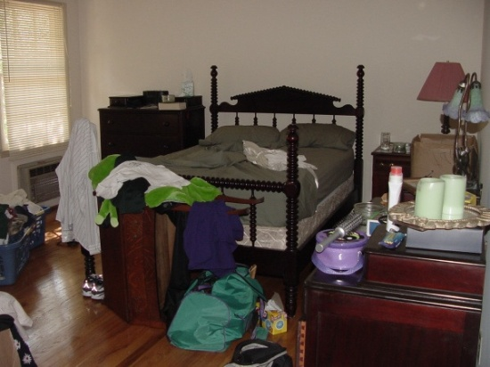
example
Situation:
Messy Bedroom
Analysis:
The untidy bedroom makes it difficult to find things or get to the bed.
Clothes and grooming items are strewn across the room
Clothes are piled near the heater which may be a fire hazard
There is limited floor space
There is nothing hanging on the wall
Possible Brief:
Design a storage wall mounted systems that would allow a variety of items to be stored neatly.

Slide 6
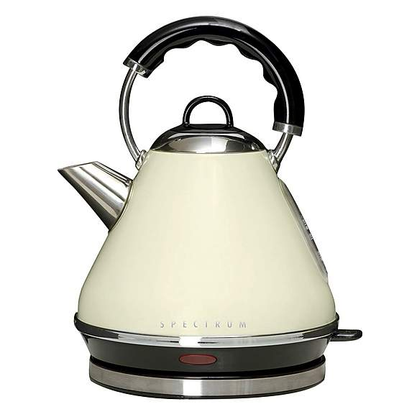
Methods of identification
Example of an existing issue:
Kettle with handle above
When pouring this kettle, the steam will rise up and potentially injure your hands
A better solution to this might be placing the handle at the rear/side, to avoid injury.
Product Evaluation
Product evaluation tests existing products and tries to find weaknesses in the product’s design.
All aspects (Design Factors) of the product will be looked at including function and performance, durability, material choice, manufacturing and assembly methods, ergonomics, aesthetics, and economics.
Once a weakness has been found, a brief can be created to allow the designer to redesign and improve the product.

Slide 7
Design brief
What information should be included in a Brief?
In its simplest form, a Brief should include two pieces of information: the Statement of Problem and the Target Market.
The Statement of Problem is a sentence, or short paragraph explaining what the problem is that has to be solved.
The Target Market is an explanation of which market group the product is aimed at or who will benefit by the solving of the problem

Slide 8
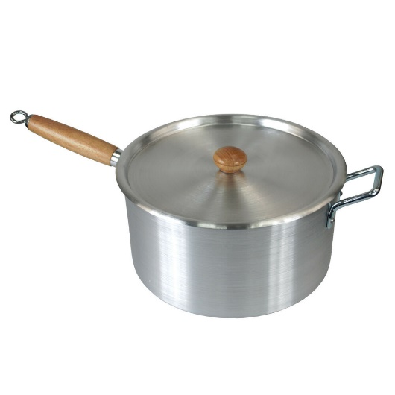
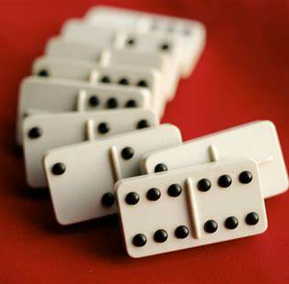
example briefs
DESIGN BRIEF 1: Design a pot handle that remains cool when the pot is heated. The users will be adults
Problem: The handle of a pot becomes too hot to hold when the pot is heated.
Target Market: people over 16 years of age.
DESIGN BRIEF 2: Design a game of dominoes that can be played by blind people.
Problem: Blind people cannot play many of the indoor games available to sighted people.
Target Market: Visually impaired people

